Slide 1



AI Master Class series – Day 22
Introduction to Machine Learning

Slide 2

Machine Learning.
Human’s knowledge is only obtained by the experience throughout their life. For machines those knowledge is need to be fed, by collecting enormous amount of data on a certain application and fed to it, machines also obtains the knowledge in short period of time.
There are three types of Machine Learning
Supervised
Unsupervised
Reinforcement

Slide 3
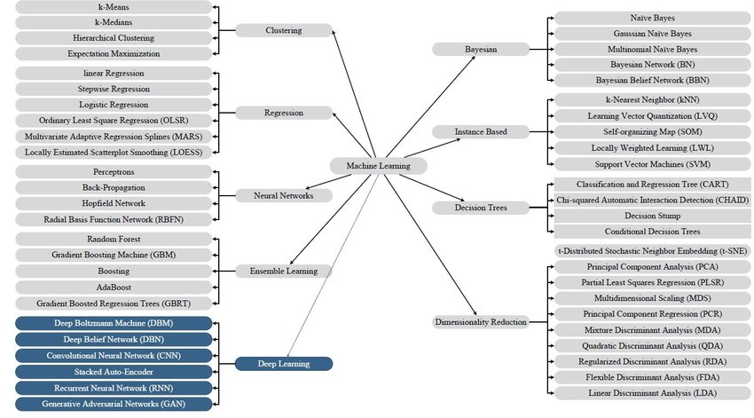

Slide 4
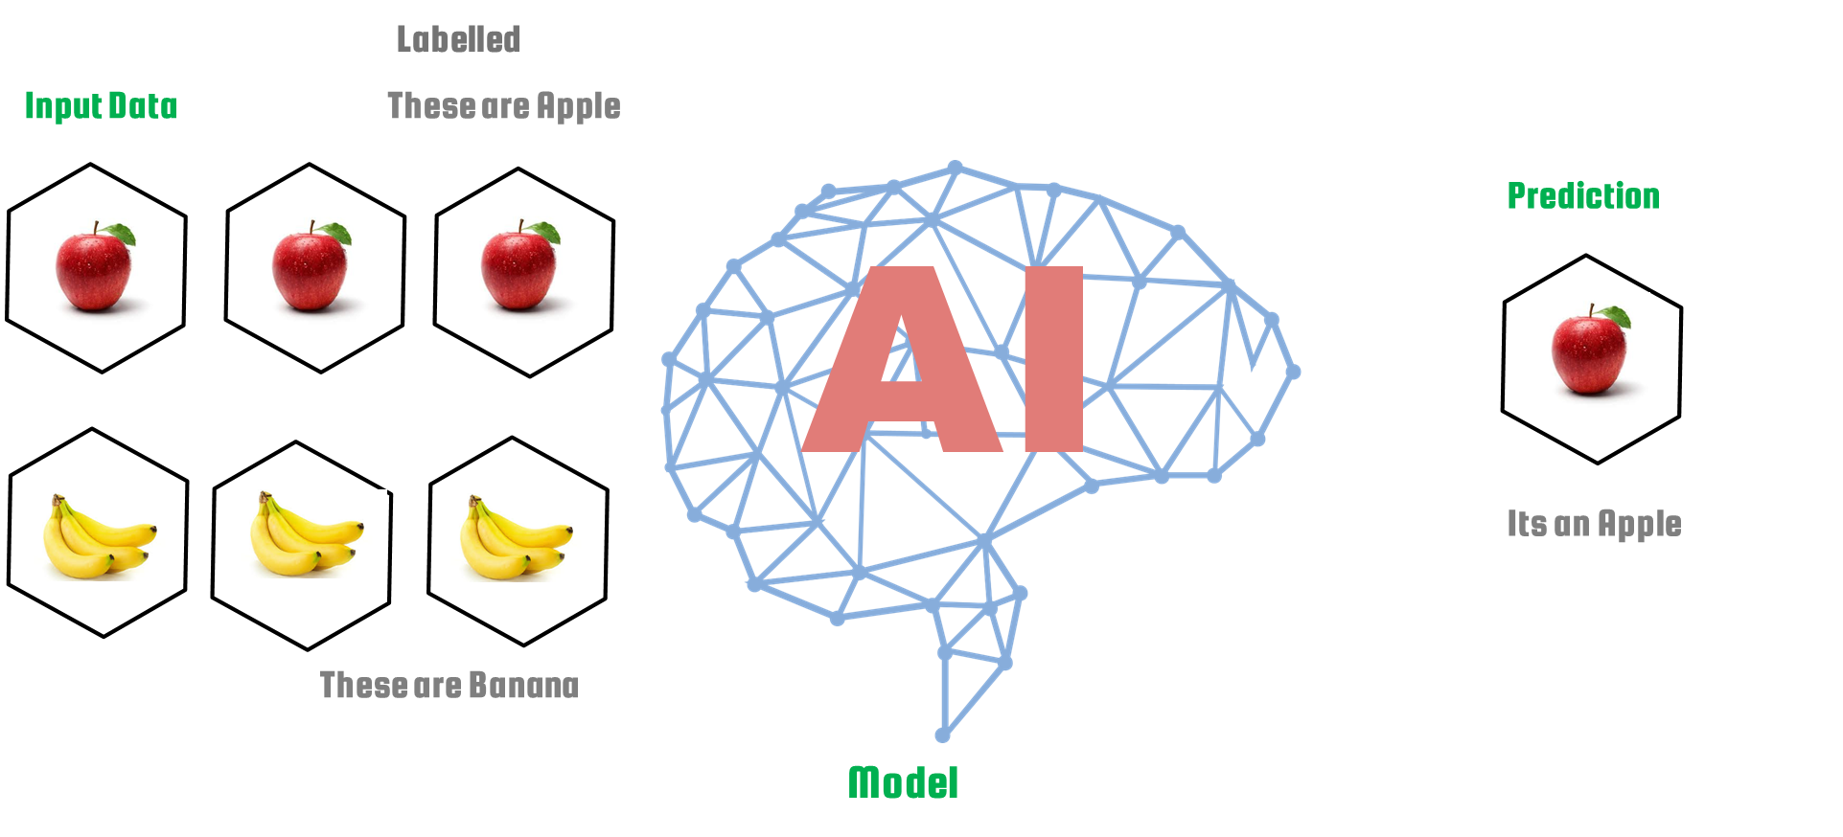
Supervised Learning.

Slide 5

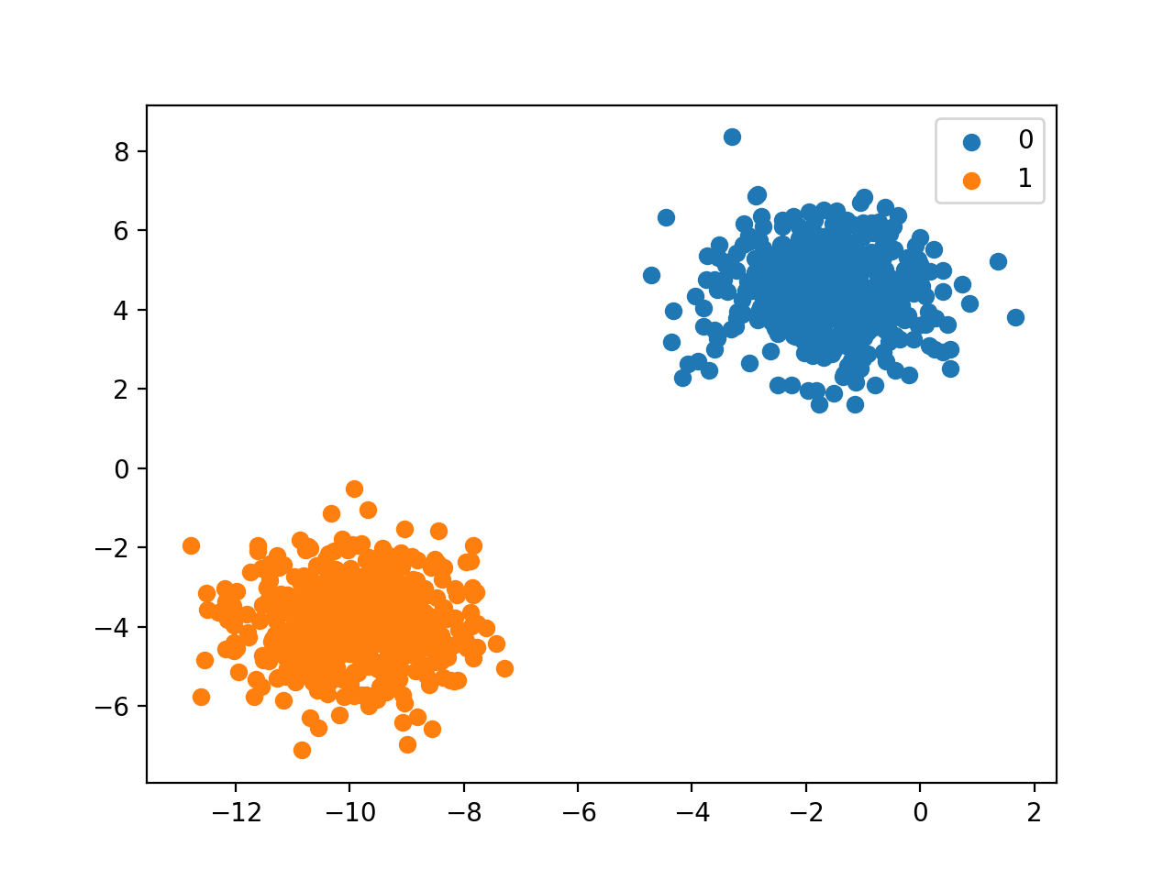
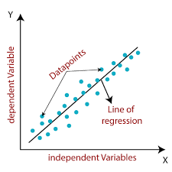
SUPERVISED LEARNING.
CLASSIFICATION
Predictive modeling problem where a class label is predicted for a given example of input data.
Given an example, classify if it is spam or not. Given a handwritten character, classify it as one of the known characters.
PREDICTION/REGRESSION
It allow us to predict a continuous outcome variable (y) based on the value of one or multiple predictor variables (x). Briefly, the goal of regression model is to build a mathematical equation that defines y as a function of the x variables.
Continuous rather than discrete

Slide 6
CLASSIFICATION PREDICTIVE MODELLING - SUPERVISED LEARNING.
Binary Classification - Classification tasks that have two class labels
Multi-Class Classification - Classification tasks that have more than two class labels.
Multi-Label Classification - classification tasks that have two or more class labels, where one or more class labels may be predicted for each example.
Imbalanced Classification - classification tasks where the number of examples in each class is unequally distributed.
IMAGE CLASSIFICATION
HAND GESTURE & LEAF DISEASE
OBJECT RECOGNITION
ROAD SIGN

Slide 7
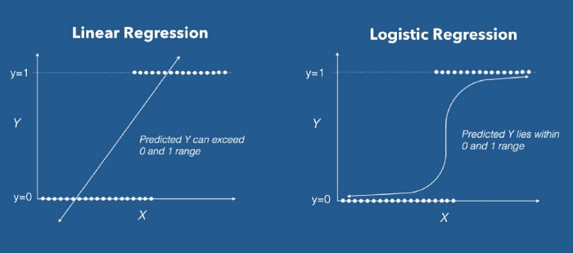
REGRESSION -SUPERVISED LEARNING.
Linear regression - Linear regression performs the task to predict a dependent variable value (y) based on a given independent variable (x). So, this regression technique finds out a linear relationship between x (input) and y(output).
Logistic regression - Logistic regression is a classification algorithm used to assign observations to a discrete set of classes.
It has activation Function
Ex: Email spam or not spam, Online transactions Fraud or not Fraud, Tumor Malignant or Benign. Logistic regression transforms its output using the logistic sigmoid function to return a probability value.

Slide 8
REGRESSION TYPES - SUPERVISED LEARNING.
Linear regression
Simple Linear-Regression
Univariate Linear Regression
Multiple Linear Regression
Locally weighted Linear Regression
Polynomial regression
Linear regression
Relationship between the independent variable x and dependent variable y is modeled as an nth degree polynomial.
Polynomial regression fits a nonlinear relationship between the value of x and the corresponding conditional mean of y, denoted E(y |x)
Growth rate of tissues.
Progression of disease epidemics
Softmax regression
Generalized Logistic regression
It handles Multiple classes

Slide 9
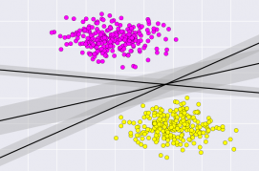
SUPPORT VECTOR MACHINES SUPERVISED LEARNING.
An SVM model is a representation of the examples as points in space, mapped so that the examples of the separate categories are divided by a clear gap that is as wide as possible.
In addition to performing linear classification, SVMs can efficiently perform a non-linear classification, implicitly mapping their inputs into high-dimensional feature spaces.
It is discriminative classifier formally defined by a separating hyperplane.

Slide 10
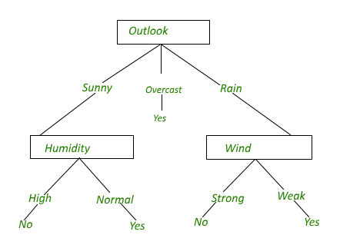
DECISION TREE - SUPERVISED LEARNING.
Decision tree is the most powerful and popular tool for classification and prediction.
A Decision tree is a flowchart like tree structure
Each internal node denotes a test on an attribute, each branch represents an outcome of the test, and each leaf node (terminal node) holds a class label.
A tree can be learned by splitting the source set into subsets based on an attribute value test.

Slide 11
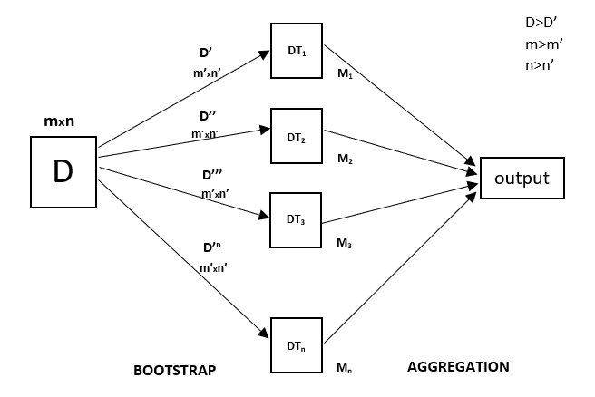
RANDOM FOREST - SUPERVISED LEARNING.
Every decision tree has high variance, but when we combine all of them together in parallel then the resultant variance is low as each decision tree gets perfectly trained on that particular sample data
hence, output doesn’t depend on one decision tree but multiple decision trees.
In the case of a classification problem, the final output is taken by using the majority voting classifier.
In the case of a regression problem, the final output is the mean of all the outputs. This part is Aggregation.

Slide 12
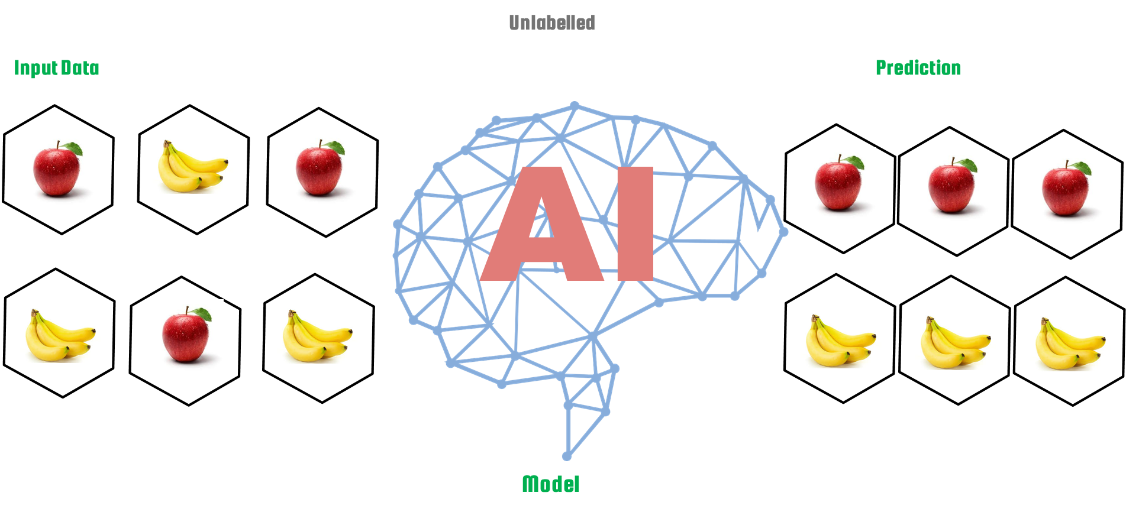
Unsupervised Learning.

Slide 13

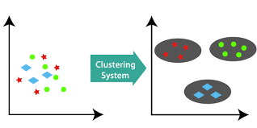
CLUSTERRING - UNSUPERVISED LEARNING.
Set of inputs is to be divided into groups.
The groups are not known beforehand, whereas classification knows

Slide 14
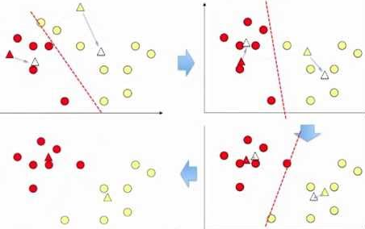
K-Means CLUSTERRING - UNSUPERVISED LEARNING.
Randomly select ‘c’ cluster centers.
Calculate the distance between each data point and cluster centers.
Assign the data point to the cluster center whose distance from the cluster center is minimum of all the cluster centers..
Recalculate the new cluster center
Recalculate the distance between each data point and new obtained cluster centers.
If no data point was reassigned then stop, otherwise repeat from step 3).

Slide 15
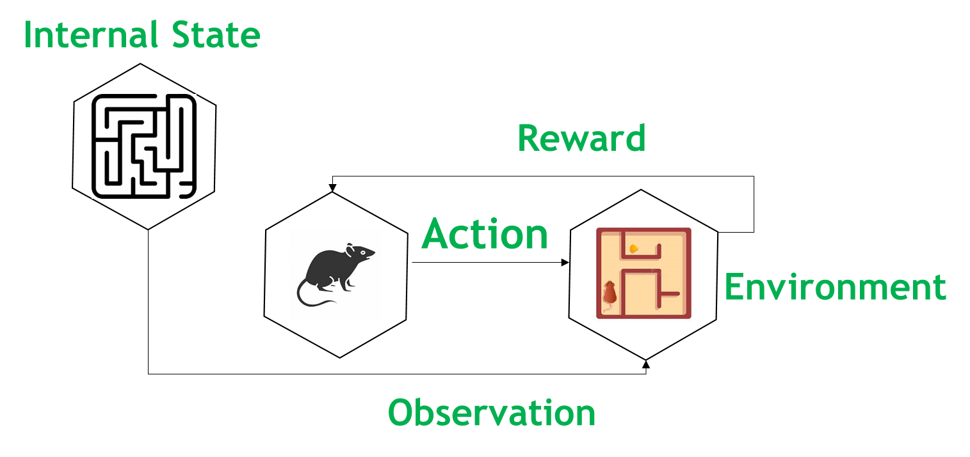
Reinforcement Learning.

Slide 16
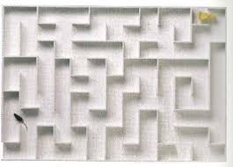
REINFORCEMENT LEARNING.
It is about taking suitable action to maximize reward in a particular situation.
It is employed by various software and machines to find the best possible behavior or path it should take in a specific situation.
Output depends on the state of the current input and the next input depends on the output of the previous input
Positive
Negative

Slide 17

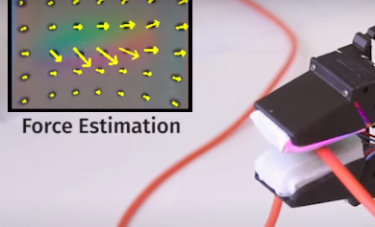
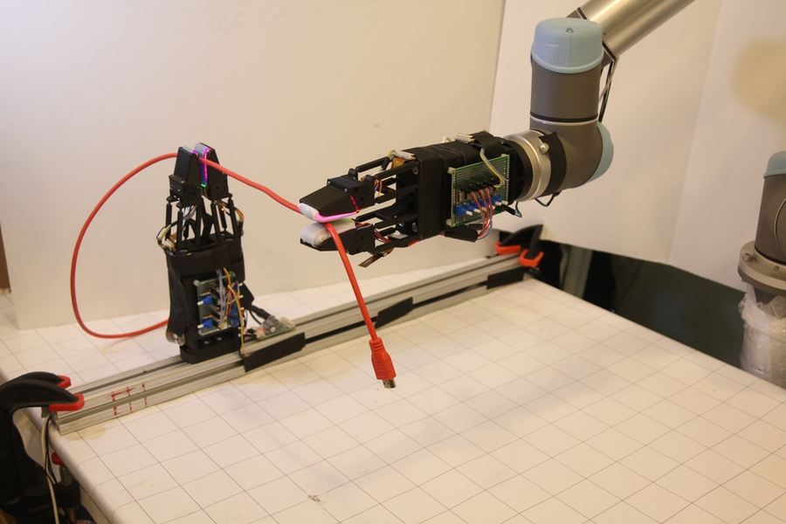
AI News – Day 22. JULY - 2020
Robotic gripper with soft sensitive fingers developed at MIT can handle cables with unprecedented dexterity.
For humans, it can be challenging to manipulate thin flexible objects like ropes, wires, or cables. But if these problems are hard for humans, they are nearly impossible for robots.
As a cable slides between the fingers, its shape is constantly changing, and the robot’s fingers must be constantly sensing and adjusting the cable’s position and motion.

Slide 18

Thanks!
Tomorrow session
Evaluating ML Algorithms

Slide 19
Day-22 Agenda.
01.
02.
03.
Machine Learning
ML Types
Q & A
Machine Learning & Types
Machine learning Algorithms based on Types

